Slide 1
Building APIs in NodeJS
John Carmichael
Director of Operations – WeSpire
john@wespire.com
@JohnnyC115

Slide 2
The What and Why of API
API – Application Program Interface
Used to expose the functionality of an application to external actors
Can be used to allow client applications to access an independent server side application (ex. Twitter’s web app, mobile app and Periscope all access the same backend API)
Can be used to allow partner applications to access (ex. Tweetdeck and Meerkat access Twitter’s backend API)

Slide 3


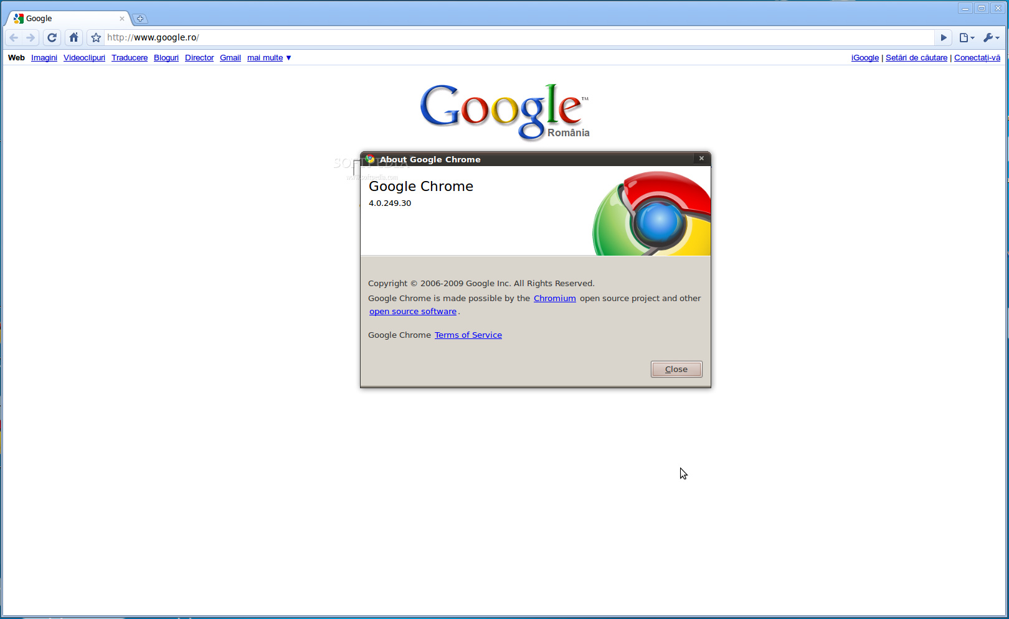



Slide 4
SOAP vs REST
SOAP – Simple Object Access Protocol
Utilizes own protocol
Focuses on exposing app logic (not data) via named operations (ex. getUser(User);)
REST – Representational State Transfer
Utilizes existing well known HTTP
Focused on CRUD (create/read/update/delete) operations on data
Notes:
https://dev.twitter.com/rest/reference/get/statuses/user_timeline

Slide 5
HTTP Methods
GET – Requests a representation of the specified resource (data retrieval)
POST – Requests that the server accept the entire enclosed in the request as a new subordinate of the web resource identified by the URI (ex. a message for a bulletin board or an item to add to a database).
HEAD – Asks for the response identical to the one that would correspond to a GET request, but without the body.
PUT – Requests that the enclosed entity be stored under the supplied URI.
DELETE – Deletes the specified resource.
TRACE – Echoes back the received request so that a client can see what changes have been made by intermediate servers.
OPTIONS – Returns the HTTP methods that the server supports for the specified URL.
CONNECT – Converts the request connection to a transparent TCP/IP tunnel, usually to facilitate SSL-encrypted communication through an unencrypted HTTP proxy.
PATCH – Applies partial modifications to a resource.

Slide 6
HTTP Methods
GET – Requests a representation of the specified resource (data retrieval)
POST – Requests that the server accept the entire enclosed in the request as a new subordinate of the web resource identified by the URI (ex. a message for a bulletin board or an item to add to a database).
HEAD – Asks for the response identical to the one that would correspond to a GET request, but without the body.
PATCH – Applies partial modifications to a resource.
PUT – Requests that the enclosed entity be stored under the supplied URI.
DELETE – Deletes the specified resource.
TRACE – Echoes back the received request so that a client can see what changes have been made by intermediate servers.
OPTIONS – Returns the HTTP methods that the server supports for the specified URL.
CONNECT – Converts the request connection to a transparent TCP/IP tunnel, usually to facilitate SSL-encrypted communication through an unencrypted HTTP proxy.

Slide 7
HTTP Status Codes
Informational – 1xx
Successful – 2xx
Redirection – 3xx
Client Error – 4xx
Server Error – 5xx

Slide 8
HTTP Status Codes
Successful – 2xx
200 OK – The request succeeded
201 Created – The request has been fulfilled and resulted in a new resource being created

Slide 9
HTTP Status Codes
Redirection – 3xx
301 Moved Permanently – The requested resource has been assigned a new permanent URI and any future references to this resource SHOULD use one of the returned URIs.
302 Found – The requested resource resides temporarily under a different URI. Since the redirection might be altered on occasion, the client SHOULD continue to use the Request-URI for future requests.

Slide 10
HTTP Status Codes
Client Error – 4xx
400 Bad Request – The request code not be understood by the server due to malformed syntax.
401 Unauthorized – The request requires user authentication.
403 Forbidden – The server understood the request but is refusing to fulfill it. The request should not be repeated.
404 Not Found – The server has not found anything matching the Request-URI.
405 Method Not Allowed – The method specified in the Request-Line is not allowed for the resource identified by the Request-URI. The response MUST include an Allow header containing a list of valid methods for the requested resource.
415 Unsupported Media Type – The server is refusing to service the request because the entity of the request is in a format not supported by the requested resource for the requested method.

Slide 11
HTTP Status Codes
Server Error – 5xx
500 Internal Server Error – The server encountered an unexpected condition which prevented it from fulfilling the request.
501 Not Implemented – The server does not support the functionality required to fulfill the request.
502 Bad Gateway – The server, while acting as a gateway or proxy, received an invalid response from the upstream server it accessed in attempting to fulfill the request.
503 Service Unavailable – The server is currently unable to handle the request due to a temporary overloading or maintenance of the server.
504 Gateway Timeout – The server, while acting as a gateway or proxy, did not receive a timely response from the upstream server specified by the URI (e.g. HTTP, FTP, LDAP) or some other auxiliary server (e.g. DNS) it needed to access in attempting to complete the request.

Slide 12
How Do HTTP?
Request
GET /student?name=Andrew%20Borstein&cohort=Spring2015 HTTP/1.1
Host: siber.com
POST /student HTTP/1.1
Host: siber.com
Content-Type: application/x-www-form-urlencoded
Content-Length: 53
name=Andrew%20Borstein&cohort=Spring2015

Slide 13
How Do HTTP?
Response
HTTP/1.1 200 OK
Date: Mon, 3 Aug 2015 19:38:34 GMT
Server: Apache/1.3.3.7 (Unix) (Red-Hat/Linux)
Last-Modified: Fri, 31 Jul 2015 12:17:09 GMT
ETag: "3f80f-1b6-3e1cb03b"
Content-Type: text/html; charset=UTF-8
Content-Length: 110
Accept-Ranges: bytes
Connection: close
<html>
<head>
<title>HTTP - Response</title>
</head>
<body>
Oooooo look at all this HTML!!!!
</body>
</html>

Slide 14
cURLing Me Softly
cURL is a tool for client-side URL transfers which supports multiple protocols including HTTP
Common Options
X – Sets custom request method
d – Passes data in the request body
H – Sets a header value
i – Include the HTTP Headers in Output
curl http://jsonip.com

Slide 15

And Then There Was Node
JavaScript was initially only available in browsers
Native Objects: String, Array, Date, etc.
Host (Browser) Objects: Window, Document, XMLHttpRequest, etc.
Google Chrome’s V8 Engine
NodeJS created by Ryan Dahl
New Host Objects: http, fs, url, os, etc.
Atwood’s Law: Anything that can be written in JavaScript eventually will be.
Notes:
Jeff Atwood – Co-Founder of StackExchange
Module Search:
* Start with searching for ‘node_modules’ directory within current directory
* Traverse tree upward one folder at a time looking for ‘node_modules’

Slide 16
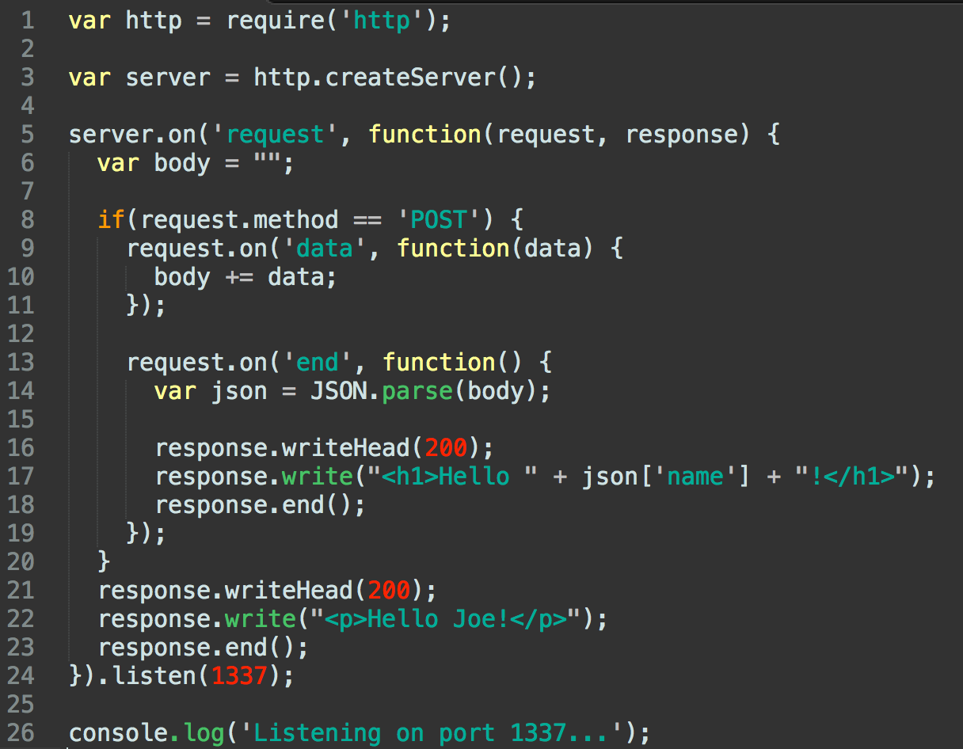

Slide 17

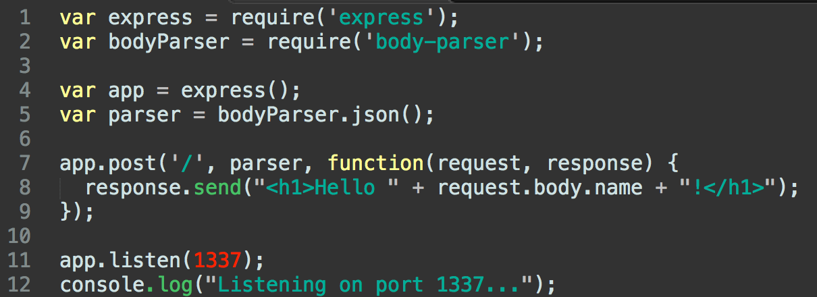
A Better Way
ExpressJS – A fast minimalist web framework for NodeJS

Slide 18
Don’t Go It Alone
Middleware – any number of functions that are invoked by the Express routing layer before your final request handler
Notes:
https://www.npmjs.com/

Slide 19
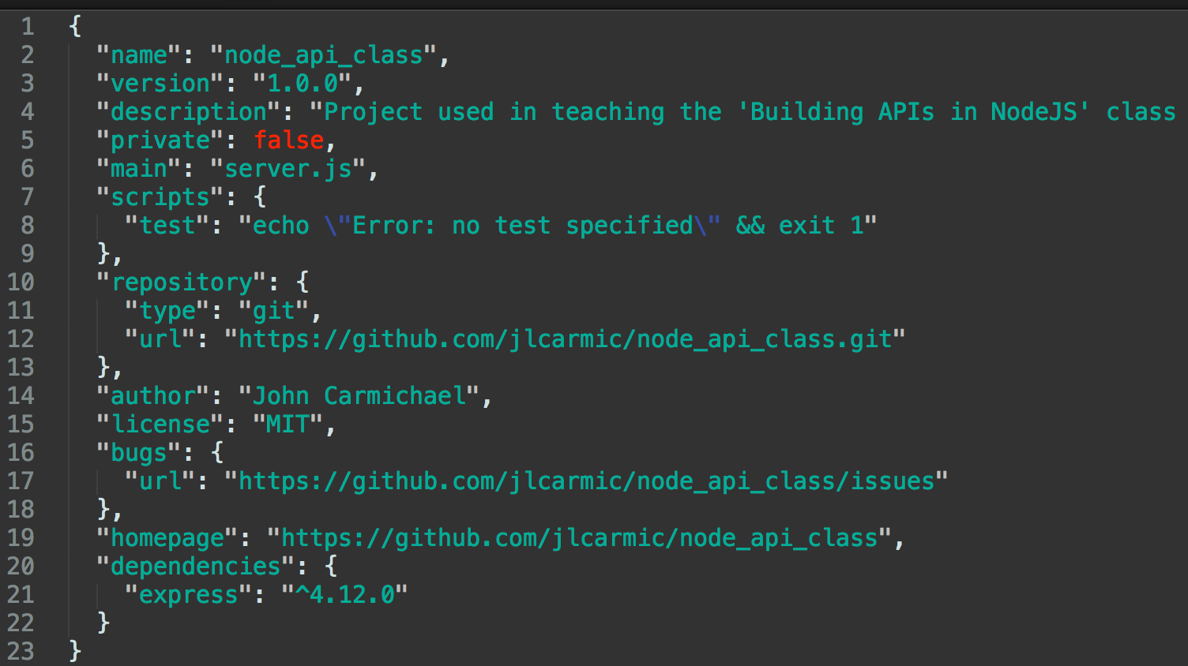
We Don’t Need No Stinking Packages
NPM – Node Package Manager
Comes standard with Node. Allows you to easily install extra packages
npm install –-save express
Notes:
https://www.npmjs.com/

Slide 20


Slide 21
Review
APIs allow us to expose application logic to external actors.
REST leverages pre-defined HTTP to create data driven APIs.
NodeJS gives us JavaScript outside of the browser which allows for server-side coding as we just did.
Express sits on top of Node and gives us faster/cleaner access to HTTP requests and responses.

Slide 22
Review
Middleware allows us to preprocess the request before our function runs.
There are many packages available to extend Node’s functionality such as Sequelize for interacting with SQL databases.
NPM allows us to easily manage all the packages we need for our project.

